Slide 1
20 AGENTS IN 30 DAYS
AI-Powered Automation for OneDevelopment
DeepAgents Framework • LangSmith Agent Builder • Cursor AI
OneUAE | December 2025

Slide 2
📋 AGENDA
01
Why AI Agents for OneDevelopment?
02
Our Tech Stack & Tools
03
30-Day Implementation Roadmap
04
20 Agents for Employee Productivity
05
Expected Impact & ROI

Slide 3
🏢 WHY AI AGENTS FOR ONEDEVELOPMENT?
20
30
500+
AGENTS
DAYS
HRS/MONTH
Challenges We're Solving:
✓ Manual property data entry and market research
✓ Repetitive client inquiries across sales teams
✓ Document processing for contracts and agreements
✓ Project tracking across multiple developments
✓ Employee onboarding and HR processes

Slide 4
🔧 OUR DEVELOPMENT STACK
DeepAgents
LangSmith Builder
Cursor AI
Complex Multi-Step Tasks
Rapid No-Code Agents
10x Dev Speed
• Planning & task breakdown
• Natural language config
• AI code generation
• Persistent memory
• Built-in learning
• Multi-file editing
• Subagent delegation
• Pre-built templates
• Shell automation
• UAE market context
• API integrations
• Real-time assistance
⚡ INTEGRATION: All agents connect to Nova AI & OneDevelopment systems
PropertyFinder API • Bayut API • Internal CRM • Document Management

Slide 5
📅 WEEK 1: FOUNDATION (Days 1-7)
🎯 5 Agents
Agent 1
Nova Enhancement Agent
Enhances Nova AI with deeper property knowledge
Agent 2
Property Data Collector
Auto-scrapes listings from PropertyFinder & Bayut
Agent 3
Client Inquiry Router
Routes & prioritizes client inquiries to right teams
Agent 4
Document Summarizer
Summarizes contracts, agreements, legal docs
Agent 5
Meeting Notes Agent
Auto-generates meeting notes & action items
🔧 Week 1 Focus: Core infrastructure & customer-facing agents

Slide 6
📅 WEEK 2: SALES & MARKETING (Days 8-14)
🎯 5 Agents
Agent 6
Lead Qualification Agent
Scores & qualifies inbound property leads
Agent 7
Market Analysis Agent
UAE real estate trends & competitor analysis
Agent 8
Email Campaign Agent
Personalizes property marketing emails
Agent 9
Social Media Agent
Creates property posts for Instagram/LinkedIn
Agent 10
Client Follow-up Agent
Automated follow-ups with interested buyers
📈 Week 2 Focus: Revenue-generating agents for sales team

Slide 7
📅 WEEK 3: OPERATIONS (Days 15-21)
🎯 5 Agents
Agent 11
Project Tracker Agent
Tracks construction milestones & deadlines
Agent 12
Vendor Management Agent
Manages supplier communications & orders
Agent 13
Quality Checklist Agent
Construction quality inspection tracking
Agent 14
Budget Monitor Agent
Tracks project expenses & budget alerts
Agent 15
Compliance Agent
UAE RERA regulations & permit tracking
🏗️ Week 3 Focus: Development & construction efficiency

Slide 8
📅 WEEK 4: HR & DEPLOYMENT (Days 22-30)
🎯 5 Agents
Agent 16
HR Onboarding Agent
New employee onboarding & training
Agent 17
Knowledge Base Agent
Internal docs search & policy lookup
Agent 18
IT Support Agent
First-line IT troubleshooting
Agent 19
Performance Report Agent
Weekly/monthly KPI reports
Agent 20
Agent Orchestrator
Meta-agent coordinating all 19 agents
🚀 Week 4 Includes: Production deployment, testing, training
All 20 agents integrated with OneDevelopment infrastructure

Slide 9
🏢 AGENTS BY DEPARTMENT
💼 SALES
📣 MARKETING
🏗️ OPERATIONS
• Lead Qualification
• Email Campaign
• Project Tracker
• Client Follow-up
• Social Media
• Vendor Mgmt
• Client Inquiry Router
• Market Analysis
• Quality Checklist
• Budget Monitor
⚖️ LEGAL/COMPLIANCE
👥 HR/ADMIN
📊 INTELLIGENCE
• Document Summarizer
• HR Onboarding
• Nova Enhancement
• Compliance Agent
• Meeting Notes
• Property Data
• IT Support
• Knowledge Base
• Performance Report
• Orchestrator

Slide 10
👥 BENEFITS FOR EMPLOYEES
🕐
Save 2-3 hours daily
Automate repetitive research & documentation tasks
📊
Better decisions
Real-time market data & competitor insights
🤝
Focus on relationships
Let agents handle admin while you build client trust
📚
Instant knowledge
Search internal policies, contracts, procedures in seconds
🎯
Higher conversions
Qualified leads with AI scoring & smart follow-ups

Slide 11
📊 EXPECTED IMPACT
70%
500+
40%
24/7
Faster lead response
Hours saved monthly
More qualified leads
Support availability
Impact by Department:
Sales:
30% faster deal cycles with automated follow-ups
Marketing:
4x content output with AI-generated campaigns
Operations:
Real-time project visibility, 50% fewer delays
HR:
90% faster onboarding, instant policy answers

Slide 12
🚀 LET'S TRANSFORM ONEDEVELOPMENT
20 AI agents tailored for OneDevelopment employees
Built with DeepAgents + LangSmith + Cursor in just 30 days
📋 Next Steps:
1. Approve the 30-day project timeline
2. Identify department champions for each agent
3. Finalize API access & system integrations
4. Kick off Week 1: Foundation phase
5. Weekly demos & feedback sessions
Ready to empower every OneDevelopment employee with AI?

Slide 13
🤖 MEET NOVA
OneDevelopment's AI Assistant - Already Live!
http://13.62.188.127:3000/
GPT-4 Powered • Property Knowledge • 24/7 Available • Multi-Source Intelligence

Slide 14
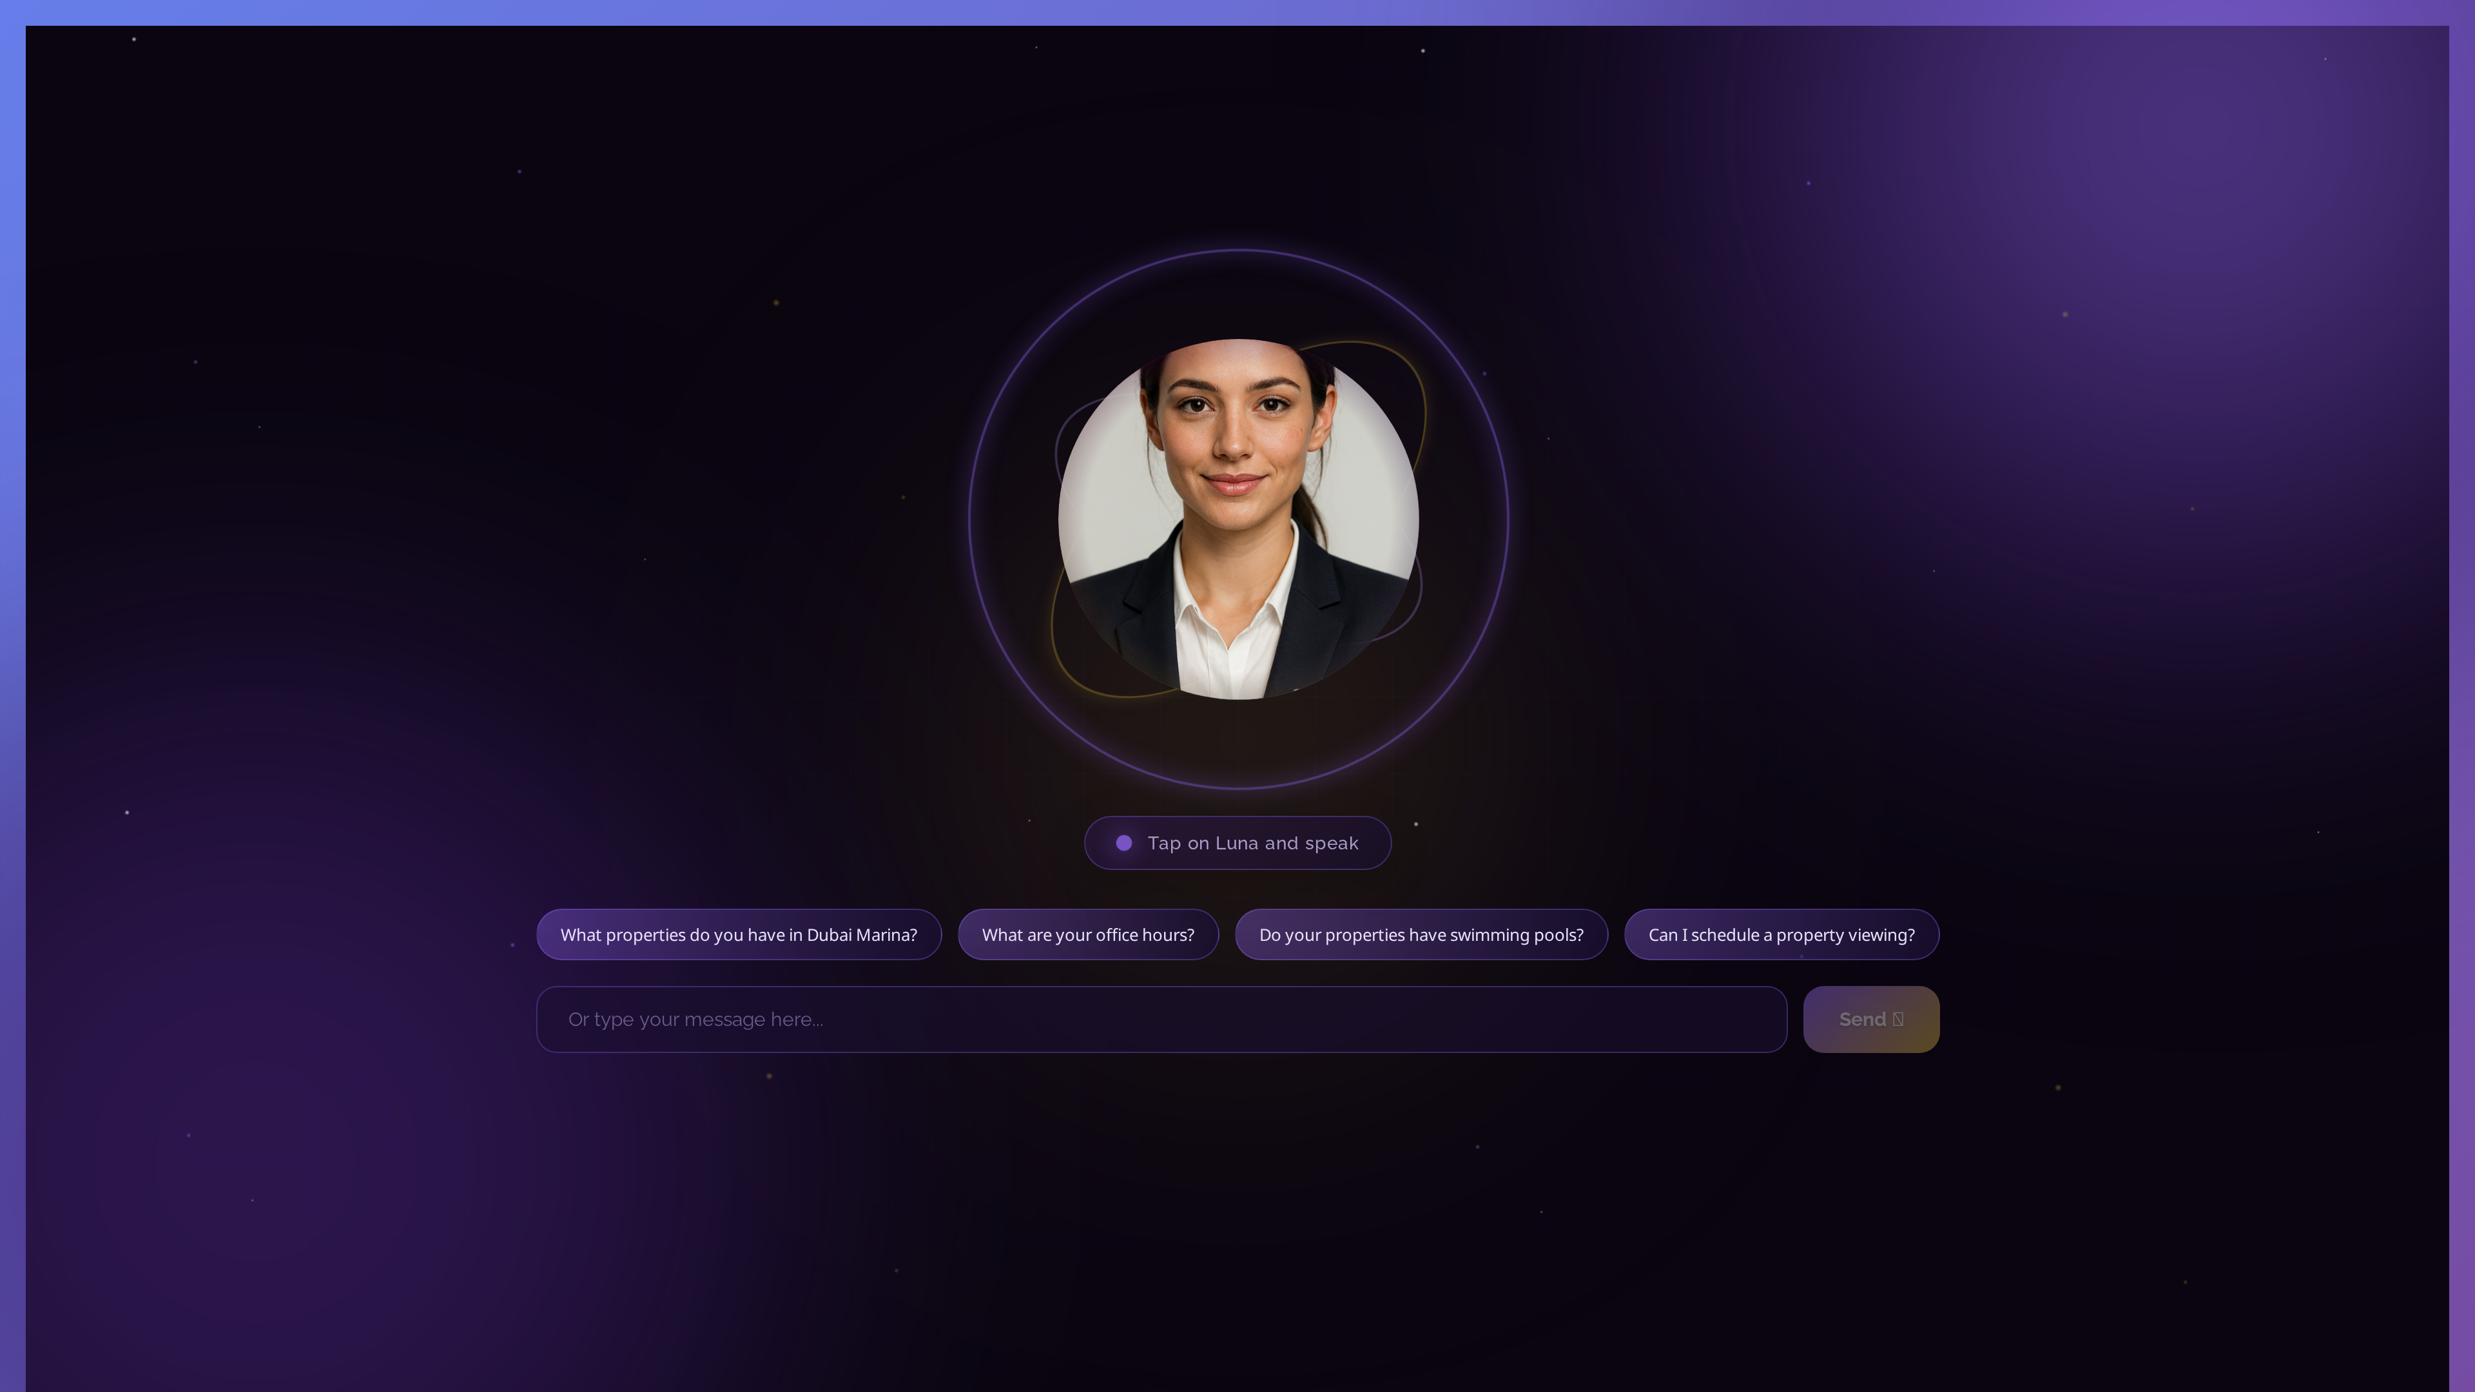
🖥️ NOVA - LANDING PAGE
Clean, modern interface welcoming OneDevelopment visitors

Slide 15
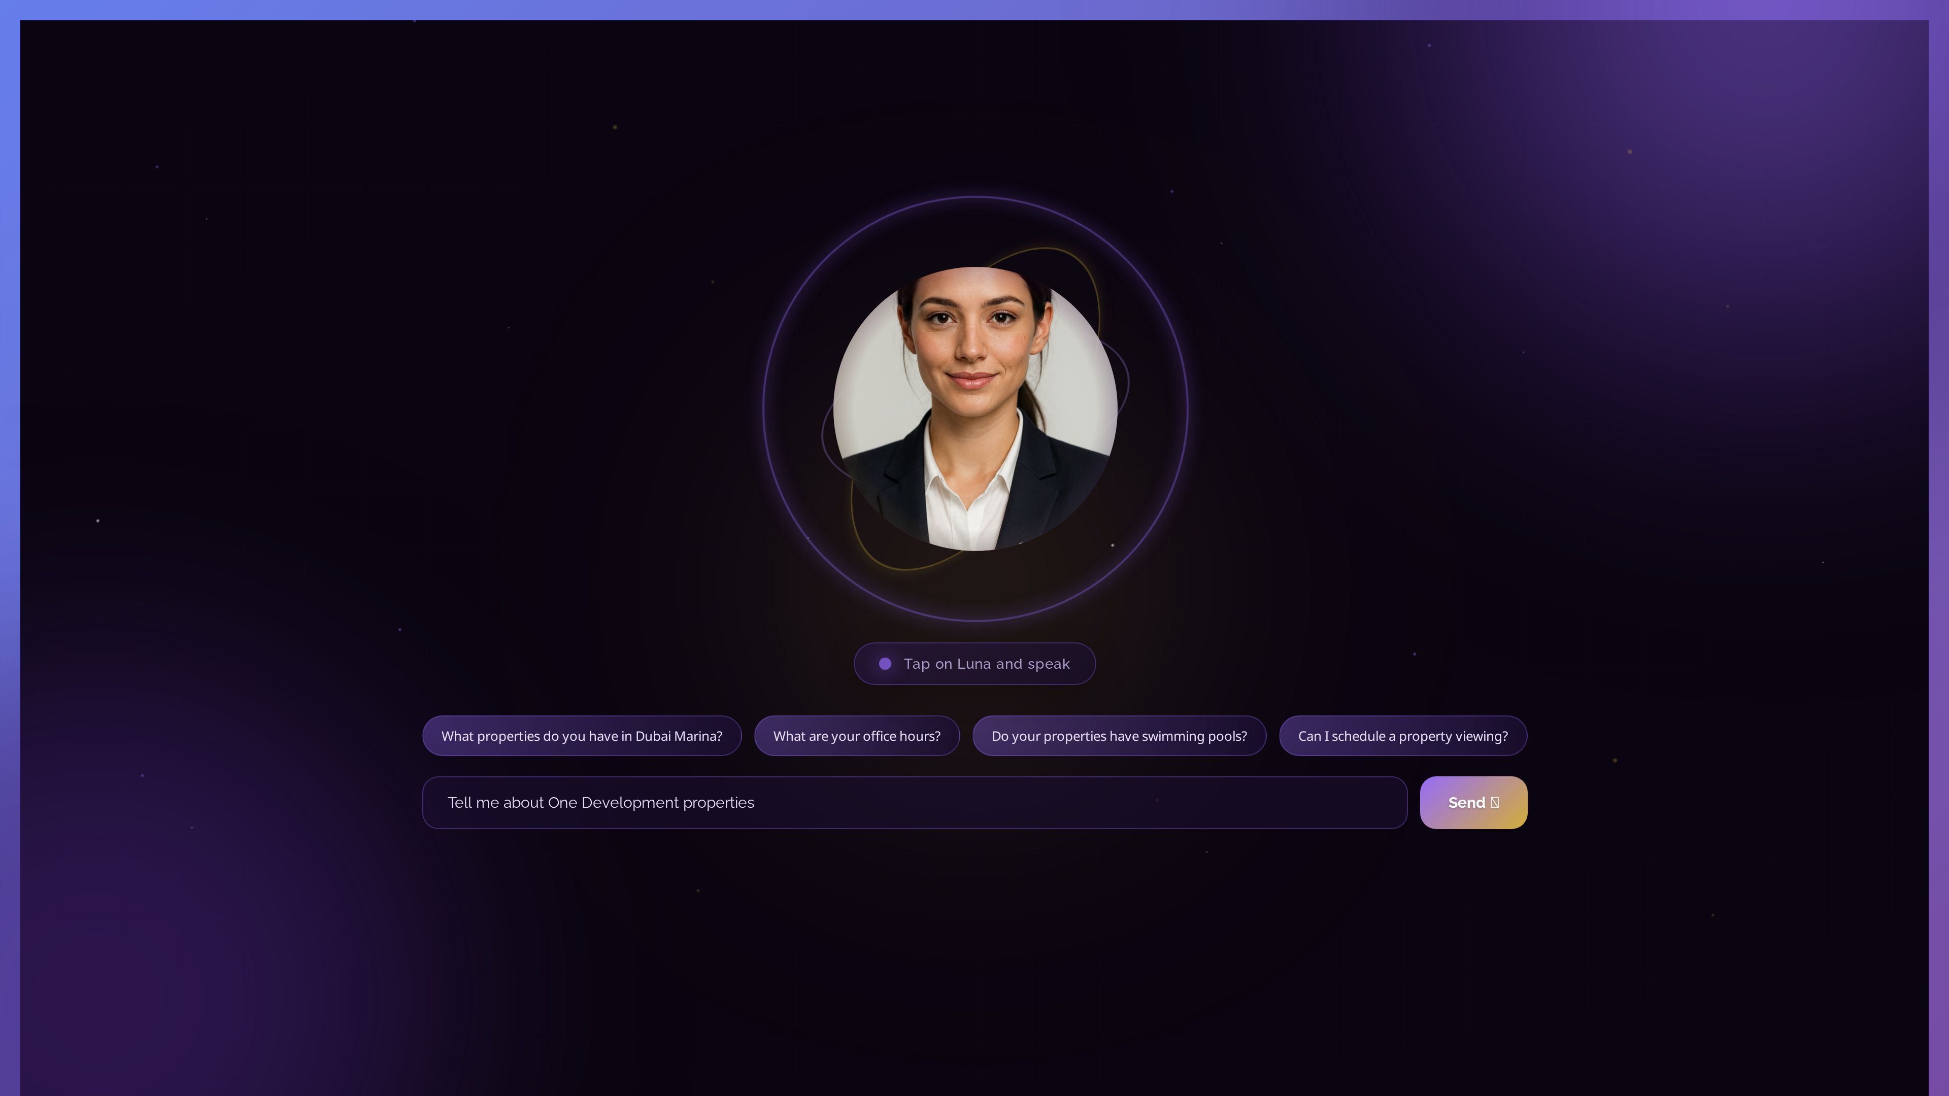
💬 NOVA - CHAT INTERFACE
Natural language conversation about properties

Slide 16
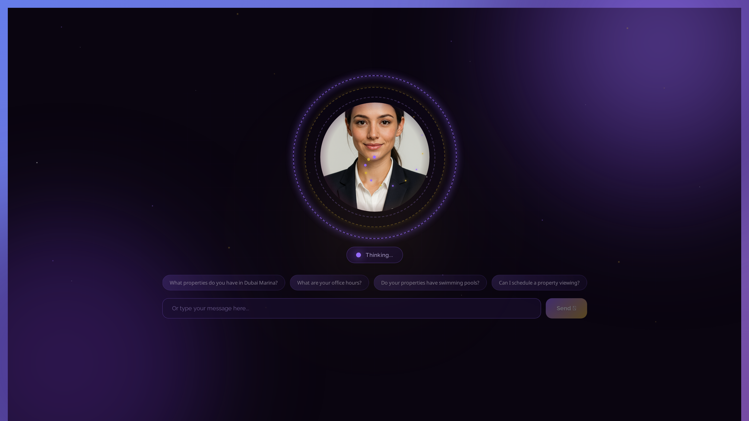
🧠 NOVA - AI RESPONSE
Intelligent, context-aware property information

Slide 17
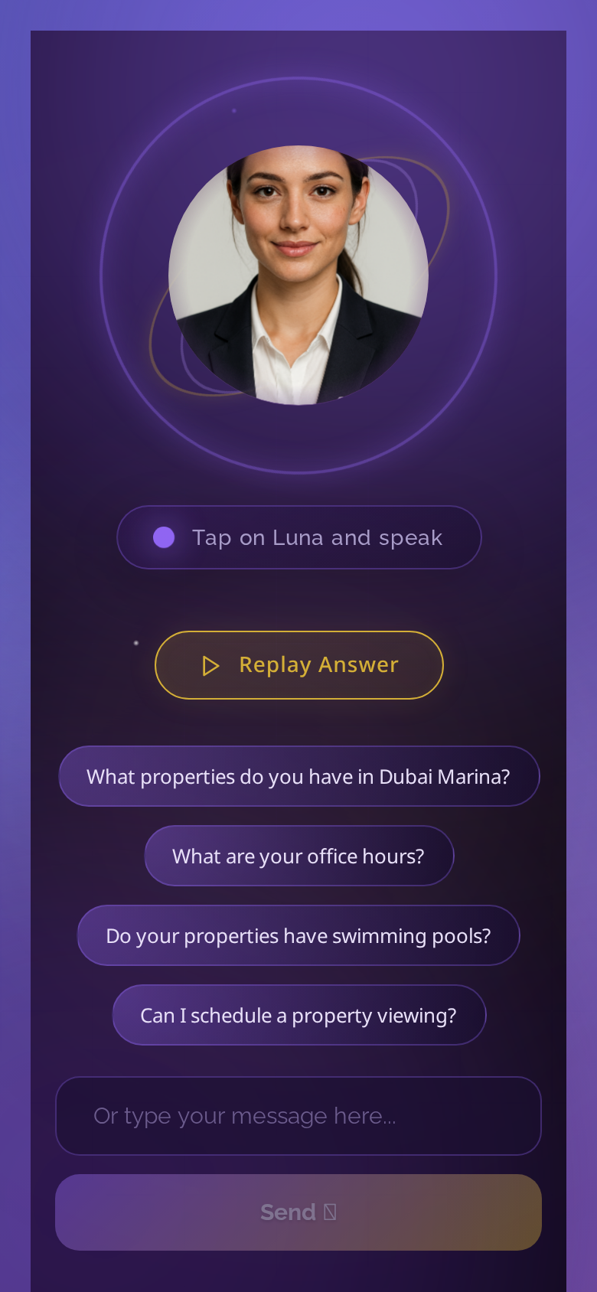
📱 NOVA - MOBILE VIEW
Responsive design for on-the-go access

